Slide 1
MODULE III: PHP
PHP: Introduction to server-side Development with PHP, Arrays, and Superglobals, Arrays, $GET and $ POST, Super global Arrays, $_SERVER Array, $_Files Array, Reading/Writing Files, PHP Classes and Objects, Object, Classes and Objects in PHP, Object Oriented Design, Working with Databases, SQL, Database APIs, Managing a MySQL Database. Accessing MySQL in PHP

Slide 2
File Handling
File handling is an important part of any web application. You often need to open and process a file for different tasks.
Manipulating Files
PHP has several functions for creating, reading, uploading, and editing files.
readfile() Function
The readfile() function reads a file and writes it to the output buffer.

Slide 3
Assume we have a text file called "webdictionary.txt", stored on the server, that looks like this:
AJAX = Asynchronous JavaScript and XML
CSS = Cascading Style Sheets
HTML = Hyper Text Markup Language
PHP = PHP Hypertext Preprocessor
SQL = Structured Query Language
SVG = Scalable Vector Graphics
XML = EXtensible Markup Language

Slide 4
Example
<!DOCTYPE html> <html> <body> <?php echo readfile("webdictionary.txt"); ?> </body> </html>

Slide 5
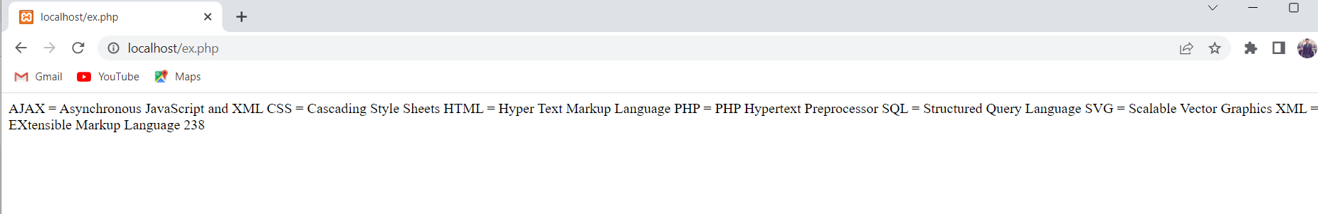
Output

Slide 6
PHP Open File - fopen()
A better method to open files is with the fopen() function.
This function gives you more options than the readfile() function.
The first parameter of fopen() contains the name of the file to be opened and the second parameter specifies in which mode the file should be opened

Slide 7
Example
<!DOCTYPE html> <html> <body> <?php $myfile = fopen("webdictionary.txt", "r") or die("Unable to open file!"); echo fread($myfile,filesize("webdictionary.txt")); fclose($myfile); ?> </body> </html>

Slide 8
The file may be opened in one of the following modes:
Modes | Description
r | Open a file for read only. File pointer starts at the beginning of the file
w | Open a file for write only. Erases the contents of the file or creates a new file if it doesn't exist. File pointer starts at the beginning of the file
a | Open a file for write only. The existing data in file is preserved. File pointer starts at the end of the file. Creates a new file if the file doesn't exist
x | Creates a new file for write only. Returns FALSE and an error if file already exists
r+ | Open a file for read/write. File pointer starts at the beginning of the file
w+ | Open a file for read/write. Erases the contents of the file or creates a new file if it doesn't exist. File pointer starts at the beginning of the file
a+ | Open a file for read/write. The existing data in file is preserved. File pointer starts at the end of the file. Creates a new file if the file doesn't exist
x+ | Creates a new file for read/write. Returns FALSE and an error if file already exists

Slide 9
PHP Read File - fread()
The fread() function reads from an open file.
The first parameter of fread() contains the name of the file to read from and the second parameter specifies the maximum number of bytes to read.
The following PHP code reads the "webdictionary.txt" file to the end:
fread($myfile,filesize("webdictionary.txt"));

Slide 10
PHP Close File - fclose()
The fclose() function is used to close an open file.
<?php
$myfile = fopen("webdictionary.txt", "r");
// some code to be executed....
fclose($myfile);
?>

Slide 11
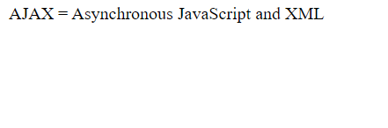
PHP Read Single Line - fgets()
The fgets() function is used to read a single line from a file.
The example below outputs the first line of the "webdictionary.txt" file:
<?php
$myfile = fopen("webdictionary.txt", "r") or die("Unable to open file!");
echo fgets($myfile);
fclose($myfile);
?>

Slide 12
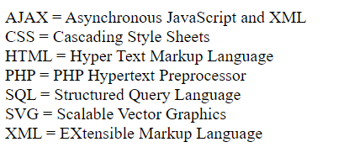
PHP Check End-Of-File - feof()
The feof() function checks if the "end-of-file" (EOF) has been reached.
The feof() function is useful for looping through data of unknown length.
The example below reads the "webdictionary.txt" file line by line, until end-of-file is reached:
<?php
$myfile = fopen("webdictionary.txt", "r") or die("Unable to open file!");
while(!feof($myfile)) { // Output one line until end-of-file
echo fgets($myfile) . "<br>";
}
fclose($myfile);
?>

Slide 13
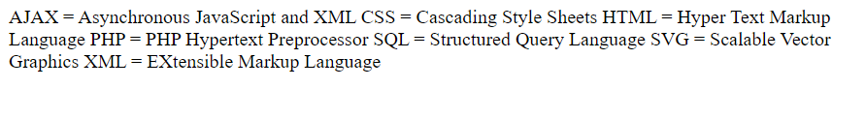
PHP Read Single Character - fgetc()
The fgetc() function is used to read a single character from a file.
The example below reads the "webdictionary.txt" file character by character, until end-of-file is reached:
<?php
$myfile = fopen("webdictionary.txt", "r") or die("Unable to open file!");
// Output one character until end-of-file
while(!feof($myfile)) {
echo fgetc($myfile);
}
fclose($myfile);
?>

Slide 14
PHP Write to File - fwrite()
The fwrite() function is used to write to a file.
The first parameter of fwrite() contains the name of the file to write to and the second parameter is the string to be written.
The example below writes a couple of names into a new file called "newfile.txt":
<?php
$myfile = fopen("newfile.txt", "w") or die("Unable to open file!");
$txt = "John William\n";
fwrite($myfile, $txt);
$txt = "John Smith\n";
fwrite($myfile, $txt);
fclose($myfile);
?>

Slide 15
Notice that we wrote to the file "newfile.txt" twice.
Each time we wrote to the file we sent the string $txt that first contained "John Doe" and second contained "Jane Doe".
After we finished writing, we closed the file using the fclose() function.
If we open the "newfile.txt" file it would look like this:
Output
John William
John Smith

Slide 16
PHP Overwriting
Now that "newfile.txt" contains some data we can show what happens when we open an existing file for writing. All the existing data will be ERASED and we start with an empty file.
In the example below we open our existing file "newfile.txt", and write some new data into it:
<?php
$myfile = fopen("newfile.txt", "w") or die("Unable to open file!");
$txt = "Mickey Mouse\n";
fwrite($myfile, $txt);
$txt = "Minnie Mouse\n";
fwrite($myfile, $txt);
fclose($myfile);
?>

Slide 17
If we now open the "newfile.txt" file, both John William and John Smith have vanished, and only the data we just wrote is present:
Output:
Mickey Mouse
Minnie Mouse

Slide 18
PHP Append Text
To append data to a file by using the "a" mode.
The "a" mode appends text to the end of the file, while the "w" mode overrides (and erases) the old content of the file.
In the example below we open our existing file "newfile.txt", and append some text to it:

Slide 19
<?php
$myfile = fopen("newfile.txt", "a") or die("Unable to open file!");
$txt = "Donald Duck\n";
fwrite($myfile, $txt);
$txt = “Harshith\n";
fwrite($myfile, $txt);
fclose($myfile);
?>

Slide 20
If we now open the "newfile.txt" file, we will see that Donald Duck and Harshith is appended to the end of the file:
Output:
Mickey Mouse Minnie Mouse Donald Duck Harshith

Slide 21
PHP What is OOP?
OOP stands for Object-Oriented Programming.
Procedural programming is about writing procedures or functions that perform operations on the data, while object-oriented programming is about creating objects that contain both data and functions.

Slide 22
Object-oriented programming has several advantages over procedural programming:
OOP is faster and easier to execute
OOP provides a clear structure for the programs
OOP helps to keep the PHP code DRY "Don't Repeat Yourself", and makes the code easier to maintain, modify and debug
OOP makes it possible to create full reusable applications with less code and shorter development time

Slide 23
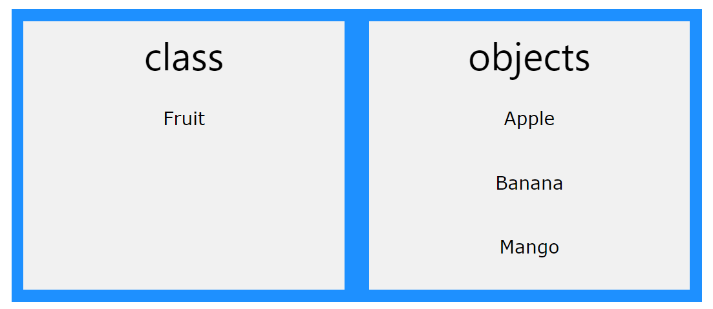
PHP - What are Classes and Objects?
Classes and objects are the two main aspects of object-oriented programming.
Look at the following illustration to see the difference between class and objects:

Slide 24
So, a class is a template for objects, and an object is an instance of a class.
When the individual objects are created, they inherit all the properties and behaviors from the class, but each object will have different values for the properties.

Slide 25
OOP Case
Let's assume we have a class named Fruit. A Fruit can have properties like name, color, weight, etc. We can define variables like $name, $color, and $weight to hold the values of these properties.
When the individual objects (apple, banana, etc.) are created, they inherit all the properties and behaviors from the class, but each object will have different values for the properties.

Slide 26
Define a Class
A class is defined by using the class keyword, followed by the name of the class and a pair of curly braces ({}). All its properties and methods go inside the braces:
Syntax
<?php
class Fruit {
// code goes here...
}
?>

Slide 27
Example
<?php
class Fruit {
// Properties
public $name;
public $color;
// Methods
function set_name($name) {
$this->name = $name;
}
function get_name() {
return $this->name;
}
}
?>

Slide 28
A class named Fruit consisting of two properties ($name and $color) and two methods set_name() and get_name() for setting and getting the $name property:

Slide 29
Define Objects
Classes are nothing without objects!
To create multiple objects from a class.
Each object has all the properties and methods defined in the class, but they will have different property values.
Objects of a class is created using the new keyword.

Slide 30
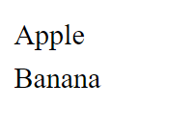
Example
<?php
class Fruit {
// Properties
public $name;
public $color;
// Methods
function set_name($name) {
$this->name = $name; }
function get_name() {
return $this->name;
}
}
$apple = new Fruit();
$banana = new Fruit();
$apple->set_name('Apple');
$banana->set_name('Banana');
echo $apple->get_name();
echo "<br>";
echo $banana->get_name();
?>
</body>
</html>

Slide 31
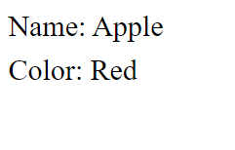
In the example below, we add two more methods to class Fruit, for setting and getting the $color property:
<?php class Fruit { // Properties public $name; public $color; // Methods function set_name($name) { $this->name = $name; } function get_name() { return $this->name; } function set_color($color) { $this->color = $color; } function get_color() { return $this->color; } }
$apple = new Fruit(); $apple->set_name('Apple'); $apple->set_color('Red'); echo "Name: " . $apple->get_name(); echo "<br>"; echo "Color: " . $apple->get_color(); ?>

Slide 32
The $this Keyword
The $this keyword refers to the current object, and is only available inside methods.
Look at the following example:
<?php class Fruit { public $name; } $apple = new Fruit(); ?>

Slide 33
So, where can we change the value of the $name property? There are two ways:
1. Inside the class (by adding a set_name() method and use $this):
<?php class Fruit { public $name; function set_name($name) { $this->name = $name; } } $apple = new Fruit(); $apple->set_name("Apple"); echo $apple->name; ?>

Slide 34
2. Outside the class (by directly changing the property value):
<?php class Fruit { public $name; } $apple = new Fruit(); $apple->name = "Apple"; echo $apple->name; ?>

Slide 35

PHP – instanceof : keyword to check if an object belongs to a specific class:
<?php
class Fruit {
}
$apple = new Fruit();
var_dump($apple instanceof Fruit);
?>

Slide 36
The __construct Function
A constructor allows you to initialize an object's properties upon creation of the object.
To create a __construct() function, PHP will automatically call this function when you create an object from a class.
Notice that the construct function starts with two underscores (__)!

Slide 37

Example:
<?php class Fruit { public $name; public $color; function __construct($name) { $this->name = $name; } function get_name() { return $this->name; } } $apple = new Fruit("Apple"); echo $apple->get_name(); ?>

Slide 38
The __destruct Function
A destructor is called when the object is destructed or the script is stopped or exited.
If you create a __destruct() function, PHP will automatically call this function at the end of the script.
Notice that the destruct function starts with two underscores (__)!

Slide 39

Example:
<?php
class Fruit {
public $name;
public $color;
function __construct($name) {
$this->name = $name;
}
function __destruct() {
echo "The fruit is {$this->name}.";
} }
$apple = new Fruit("Apple");
?>

Slide 40
Access Modifiers
Properties and methods can have access modifiers which control where they can be accessed.
There are three access modifiers:
public - the property or method can be accessed from everywhere. This is default
protected - the property or method can be accessed within the class and by classes derived from that class
private - the property or method can ONLY be accessed within the class

Slide 41
Example
<?php class Fruit { public $name; protected $color; private $weight; } $mango = new Fruit(); $mango->name = 'Mango'; // OK $mango->color = 'Yellow'; // ERROR $mango->weight = '300'; // ERROR ?>

Slide 42
OOP - Inheritance
Inheritance in OOP = When a class derives from another class.
The child class will inherit all the public and protected properties and methods from the parent class. In addition, it can have its own properties and methods.
An inherited class is defined by using the extends keyword.

Slide 43
Example
<?php class Fruit { public $name; public $color; public function __construct($name, $color) { $this->name = $name; $this->color = $color; } public function intro() { echo "The fruit is {$this->name} and the color is {$this->color}."; } }

Slide 44
// Strawberry is inherited from Fruit class Strawberry extends Fruit { public function message() { echo "Am I a fruit or a berry? "; } } $strawberry = new Strawberry("Strawberry", "red"); $strawberry->message(); $strawberry->intro(); ?>

Slide 45
Inheritance and the Protected Access Modifier
protected properties or methods can be accessed within the class and by classes derived from that class.

Slide 46
Example: 1
<?php class Fruit { public $name; public $color; public function __construct($name, $color) { $this->name = $name; $this->color = $color; } protected function intro() { echo "The fruit is {$this->name} and the color is {$this->color}."; } }

Slide 47
class Strawberry extends Fruit { public function message() { echo "Am I a fruit or a berry? "; } } // Try to call all three methods from outside class $strawberry = new Strawberry("Strawberry", "red"); // OK. __construct() is public $strawberry->message(); // OK. message() is public $strawberry->intro(); // ERROR. intro() is protected ?>

Slide 48
In the example above we see that if we try to call a protected method (intro()) from outside the class, we will receive an error. public methods will work fine!

Slide 49
Example: 2
<?php class Fruit { public $name; public $color; public function __construct($name, $color) { $this->name = $name; $this->color = $color; } protected function intro() { echo "The fruit is {$this->name} and the color is {$this->color}."; } }

Slide 50
class Strawberry extends Fruit { public function message() { echo "Am I a fruit or a berry? "; // Call protected method from within derived class - OK $this -> intro(); } } $strawberry = new Strawberry("Strawberry", "red"); // OK. __construct() is public $strawberry->message(); // OK. message() is public and it calls intro() (which is protected) from within the derived class ?>

Slide 51
PHP MySQL Database
With PHP, you can connect to and manipulate databases.
MySQL is the most popular database system used with PHP.
What is MySQL?
MySQL is a database system used on the web
MySQL is a database system that runs on a server
MySQL is ideal for both small and large applications
MySQL is very fast, reliable, and easy to use
MySQL uses standard SQL
MySQL compiles on a number of platforms
MySQL is free to download and use
MySQL is developed, distributed, and supported by Oracle Corporation

Slide 52
The data in a MySQL database are stored in tables. A table is a collection of related data, and it consists of columns and rows.
Databases are useful for storing information categorically. A company may have a database with the following tables:
Employees
Products
Customers
Orders

Slide 53
PHP Connect to MySQL
PHP 5 and later can work with a MySQL database using:
MySQLi extension (the "i" stands for improved)
PDO (PHP Data Objects)

Slide 54
Example (MySQLi Object-Oriented)
<?php
$servername = "localhost";
$username = "root";
$password = "";
// Create connection
$conn = new mysqli($servername, $username, $password);
// Check connection
if ($conn->connect_error) {
die("Connection failed: " . $conn->connect_error);
}
echo "Connected successfully";
?>

Slide 55
PHP Create a MySQL Database
A database consists of one or more tables.
The CREATE DATABASE statement is used to create a database in MySQL.
Example:
<?php
$servername = "localhost";
$username = "root";
$password = "";

Slide 56
// Create connection
$conn = new mysqli($servername, $username, $password);
// Check connection
if ($conn->connect_error) {
die("Connection failed: " . $conn->connect_error);
}
// Create database
$sql = "CREATE DATABASE myDB";
if ($conn->query($sql) === TRUE) {
echo "Database created successfully";
} else {
echo "Error creating database: " . $conn->error;
}
$conn->close();
?>

Slide 57
PHP MySQL Create Table
A database table has its own unique name and consists of columns and rows.
The CREATE TABLE statement is used to create a table in MySQL.
Example
<?php
$servername = "localhost";
$username = "root";
$password = "";
$dbname = "myDB";

Slide 58
// Create connection
$conn = new mysqli($servername, $username, $password, $dbname);
// Check connection
if ($conn->connect_error) {
die("Connection failed: " . $conn->connect_error);
}
// sql to create table
$sql = "CREATE TABLE Employee (
Emp_id INT(6) UNSIGNED AUTO_INCREMENT PRIMARY KEY,
Emp_name VARCHAR(30),
Mobile INT(10),
Email VARCHAR(50),
Salary INT(6)
)";

Slide 59
if ($conn->query($sql) === TRUE) {
echo "Table Employee created successfully";
}
else {
echo "Error creating table: " . $conn->error;
}
$conn->close();
?>

Slide 60
PHP MySQL Insert Data
After a database and a table have been created, we can start adding data in them.
Here are some syntax rules to follow:
The SQL query must be quoted in PHP
String values inside the SQL query must be quoted
Numeric values must not be quoted
The word NULL must not be quoted

Slide 61
The INSERT INTO statement is used to add new records to a MySQL table:
INSERT INTO table_name (column1, column2, column3,...) VALUES (value1, value2, value3,...)

Slide 62
Example
<?php
$servername = "localhost";
$username = "root";
$password = "";
$dbname = "myDB";
// Create connection
$conn = new mysqli($servername, $username, $password, $dbname);
// Check connection
if ($conn->connect_error) {
die("Connection failed: " . $conn->connect_error);
}

Slide 63
$sql = "INSERT INTO Employee (Emp_id, Emp_name, Mobile, Email, Salary)
VALUES (1, 'Harshith', 123456, 'harshith@gmail.com', 50000)";
if ($conn->query($sql) === TRUE) {
echo "New record created successfully";
} else {
echo "Error: " . $sql . "<br>" . $conn->error;
}
$conn->close();
?>

Slide 64
PHP MySQL Insert Multiple Records
<?php
$servername = "localhost";
$username = "root";
$password = "";
$dbname = "myDB";
// Create connection
$conn = new mysqli($servername, $username, $password, $dbname);
// Check connection
if ($conn->connect_error) {
die("Connection failed: " . $conn->connect_error);
}

Slide 65
$sql = "INSERT INTO Employee (Emp_id, Emp_name, Mobile, Email, Salary)
VALUES (2, 'Vihaan', 995562, 'vihaan@gmail.com', 60000);";
$sql .= "INSERT INTO Employee (Emp_id, Emp_name, Mobile, Email, Salary)
VALUES (3, 'Virat', 778866, 'virat@gmail.com', 70000);";
$sql .= "INSERT INTO Employee (Emp_id, Emp_name, Mobile, Email, Salary)
VALUES (4, 'Arun', 223345, 'arun@gmail.com', 40000)";
if ($conn->multi_query($sql) === TRUE) {
echo "New records created successfully";
} else {
echo "Error: " . $sql . "<br>" . $conn->error;
}
$conn->close();
?>

Slide 66
PHP MySQL Select Data
The SELECT statement is used to select data from one or more tables:
SELECT column_name(s) FROM table_name
or we can use the * character to select ALL columns from a table:
SELECT * FROM table_name

Slide 67
Example
<!DOCTYPE html>
<html>
<body>
<?php
$servername = "localhost";
$username = "root";
$password = "";
$dbname = "myDB";
// Create connection
$conn = new mysqli($servername, $username, $password, $dbname);
// Check connection
if ($conn->connect_error) {
die("Connection failed: " . $conn->connect_error);
}

Slide 68
$sql = "SELECT Emp_id, Emp_name, Salary FROM Employee";
$result = $conn->query($sql);
if ($result->num_rows > 0) {
// output data of each row
while($row = $result->fetch_assoc()) {
echo "<br> id: ". $row["Emp_id"]. " - Name: ". $row["Emp_name"]. " - Salary: " . $row["Salary"] . "<br>";
}
} else {
echo "0 results";
}
$conn->close();
?>

Slide 69
First, we set up an SQL query that selects the Emp_id, Emp_name and Salary columns from the Employee table.
The next line of code runs the query and puts the resulting data into a variable called $result.
The function num_rows() checks if there are more than zero rows returned.
If there are more than zero rows returned, the function fetch_assoc() puts all the results into an associative array that we can loop through.
The while() loop loops through the result set and outputs the data from the Emp_id, Emp_name and Salary columns.

Slide 70
PHP MySQL Use The WHERE Clause
The WHERE clause is used to filter records.
The WHERE clause is used to extract only those records that fulfill a specified condition.
SELECT column_name(s) FROM table_name WHERE column_name operator value

Slide 71
Example
<!DOCTYPE html>
<html>
<body>
<?php
$servername = "localhost";
$username = "root";
$password = "";
$dbname = "myDB";
$conn = new mysqli($servername, $username, $password, $dbname);
if ($conn->connect_error) {
die("Connection failed: " . $conn->connect_error);
}

Slide 72
$sql = "SELECT * FROM Employee WHERE Salary >= 50000";
$result = $conn->query($sql);
if ($result->num_rows > 0) {
// output data of each row
while($row = $result->fetch_assoc()) {
echo "<br> id: ". $row["Emp_id"]. " - Name: ". $row["Emp_name"]. " - Salary " . $row["Salary"] . "<br>";
}
} else {
echo "0 results";
}
$conn->close();
?>

Slide 73
PHP MySQL Delete Data
The DELETE statement is used to delete records from a table:
DELETE FROM table_name WHERE some_column = some_value

Slide 74
Example
<?php
$servername = "localhost";
$username = "root";
$password = "";
$dbname = "myDB";
// Create connection
$conn = new mysqli($servername, $username, $password, $dbname);
// Check connection
if ($conn->connect_error) {
die("Connection failed: " . $conn->connect_error);
}

Slide 75
// sql to delete a record
$sql = "DELETE FROM Employee WHERE Emp_id=3";
if ($conn->query($sql) === TRUE) {
echo "Record deleted successfully";
} else {
echo "Error deleting record: " . $conn->error;
}
$conn->close();
?>

Slide 76
PHP MySQL Update Data
The UPDATE statement is used to update existing records in a table:
UPDATE table_name SET column1=value, column2=value2,... WHERE some_column=some_value

Slide 77
Example
<?php
$servername = "localhost";
$username = "root";
$password = "";
$dbname = "myDB";
// Create connection
$conn = new mysqli($servername, $username, $password, $dbname);
// Check connection
if ($conn->connect_error) {
die("Connection failed: " . $conn->connect_error);
}

Slide 78
$sql = "UPDATE Employee SET Salary=90000 WHERE Emp_id=2";
if ($conn->query($sql) === TRUE) {
echo "Record updated successfully";
} else {
echo "Error updating record: " . $conn->error;
}
$conn->close();
?>

Slide 79
Example: student.html
<html>
<body>
<h1> Student Information</h1>
<form action="student.php" method="post">
Name: <input type="text" name="name"><br>
E-mail: <input type="text" name="email"><br>
<input type="submit">
</form>
</body>
</html>

Slide 80
Student.php
<?php
$servername = "localhost";
$username = "root";
$password = "";
$dbname = "login";
$x=$_POST['name'];
$y=$_POST['email'];
// Create connection
$conn = new mysqli($servername, $username, $password, $dbname);
// Check connection
if ($conn->connect_error) {
die("Connection failed: " . $conn->connect_error);
}

Slide 81
$sql = "INSERT INTO login (Name, email)
VALUES ('$x','$y')";
if ($conn->query($sql) === TRUE) {
echo "New record created successfully";
} else {
echo "Error: " . $sql . "<br>" . $conn->error;
}
$conn->close();
?>

